Slide 1
Anthropogenic Climate Change
A very, very brief introduction.

Slide 2
Consilience of Evidence
Physics and Chemistry: Since the 1800s, we’ve known that certain gasses trap heat creating a greenhouse effect.
Water vapor and other aerosols
Nitrous Oxide
Methane
CO₂
All of these work by trapping energy from the sun.
Historical Record
Reconstruction of historical temperatures using deep sea sediments and ice cores from the arctic and Antarctic. Scientists use the ratio of the two naturally occurring isotopes of oxygen, ¹⁸O and ¹⁶O, to extrapolate temperature data before the historical record, and direct measurement statistically adjusted to control for biased readings after the advent of regular meteorological record keeping.
Direct measurement of historical CO₂ concentrations from air trapped in ice cores collected from arctic and Antarctic, as well as direct measurement of atmospheric CO₂ concentrations in the contemporary period.

Slide 3
Consilience of Evidence
Comparisons to other sources of GHG emissions.
Scientists can rule out other possible sources of GHG to conclude that human caused emissions are currently the primary driver of climate change.
Volcanoes, for example, emit a much smaller amount of GHG globally each year than we are finding in the atmosphere.
GHG from human sources have a different chemical signature than GRG from other sources; a different carbon isotope from fossil fuels.
Comparisons to other causes of warming.
Scientists can rule out other potential causes of rising temperatures such as changes in earth’s orbit.
GHGs create a specific pattern of warming. The temperature rises near the surfaces, but this is paired with cooling of the upper atmosphere.
Orbital changes would warm the atmosphere more uniformly.

Slide 4
Historical CO₂ Levels
https://climate.nasa.gov/vital-signs/carbon-dioxide/
Over last 1 million years: 172-300 PPM
First broke 300: around the time the Titanic sank (1911)
June 2019: 413.93 PPM

Slide 5
Temperature and CO₂
https://www.ncdc.noaa.gov/global-warming/temperature-change

Slide 6
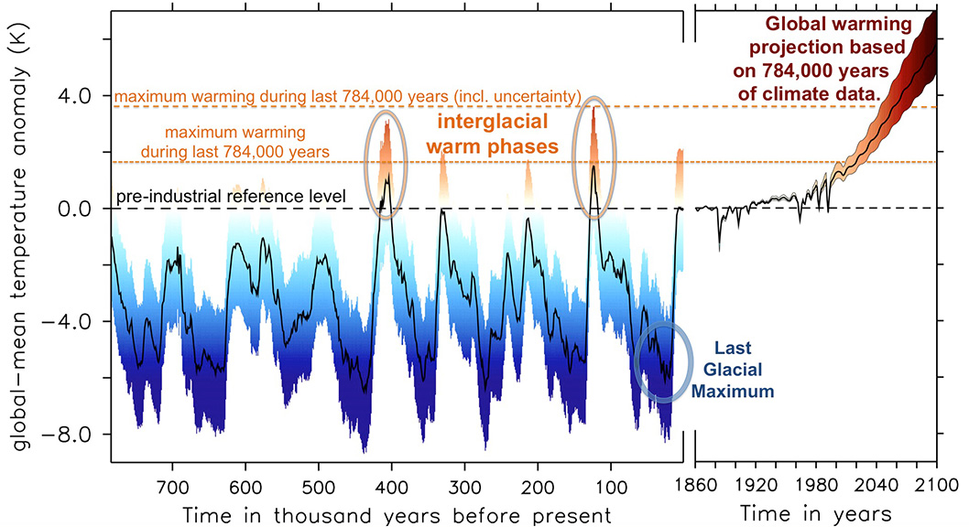
Projections of Rising Global Temperature

Slide 7
Likely Effects
 | @1.5°C Warming | @2°C Warming
Ice-Free Arctic Summer | 1 per century | 1 per decade
World Population affected by extreme heat waves | 14% | 37%
Urban Water Scarcity | +350 million people | +411 million people
Plant & Animal Loss | 6% of insects 8% of plants 4%of vertebrates | 18% of insects 16% of plants 8% of vertebrates
Coral Reef Loss | 80% | > 99%
Sea Level Rise and Effects | 31-69 million exposed to flooding | Additional 10cm rise. 32-80 million exposed to flooding

Slide 9
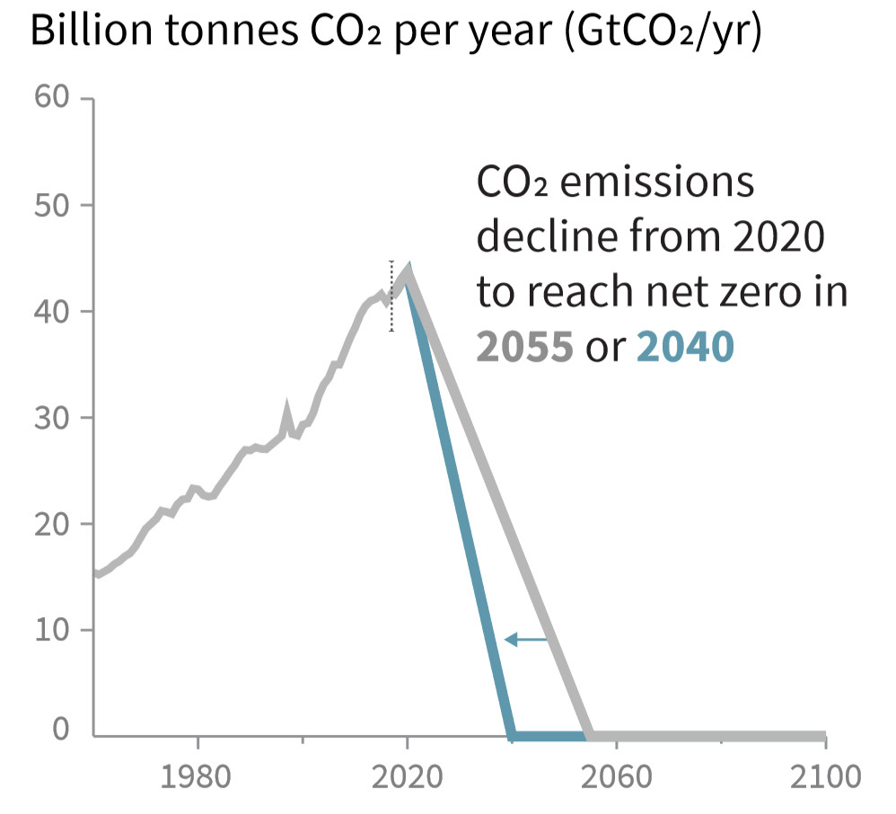
What we must do…
http://report.ipcc.ch/sr15/pdf/sr15_spm_final.pdf

Slide 11
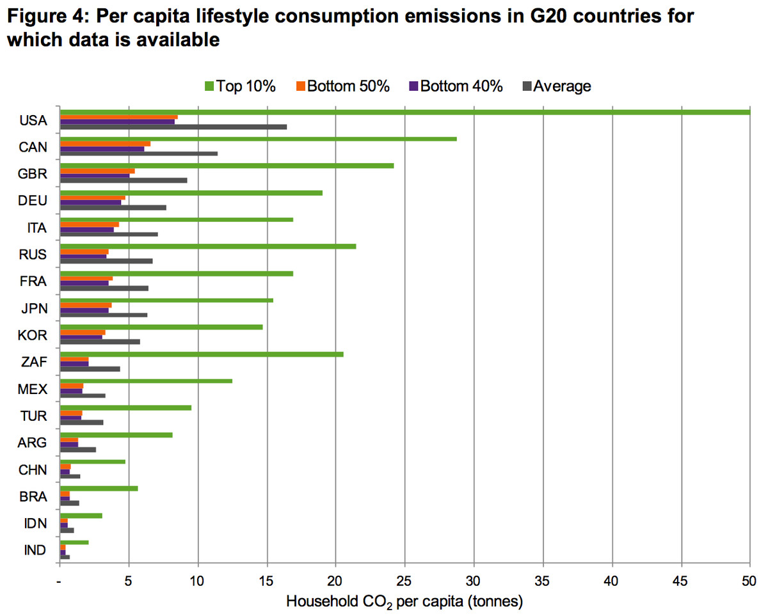
Where should we focus?
Oxfam

