Slide 1
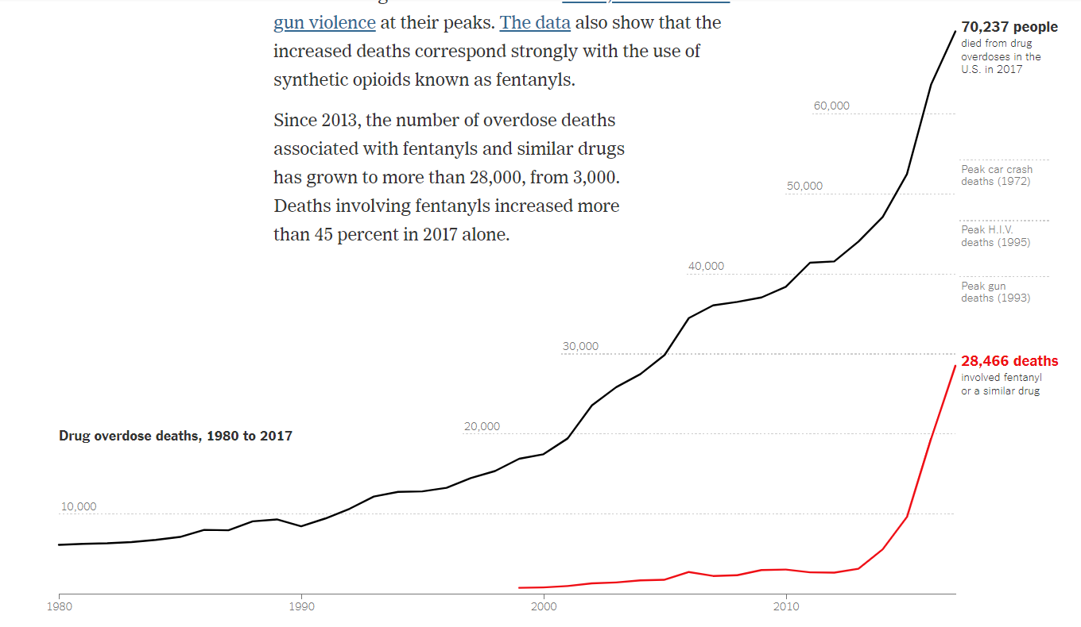

Slide 3
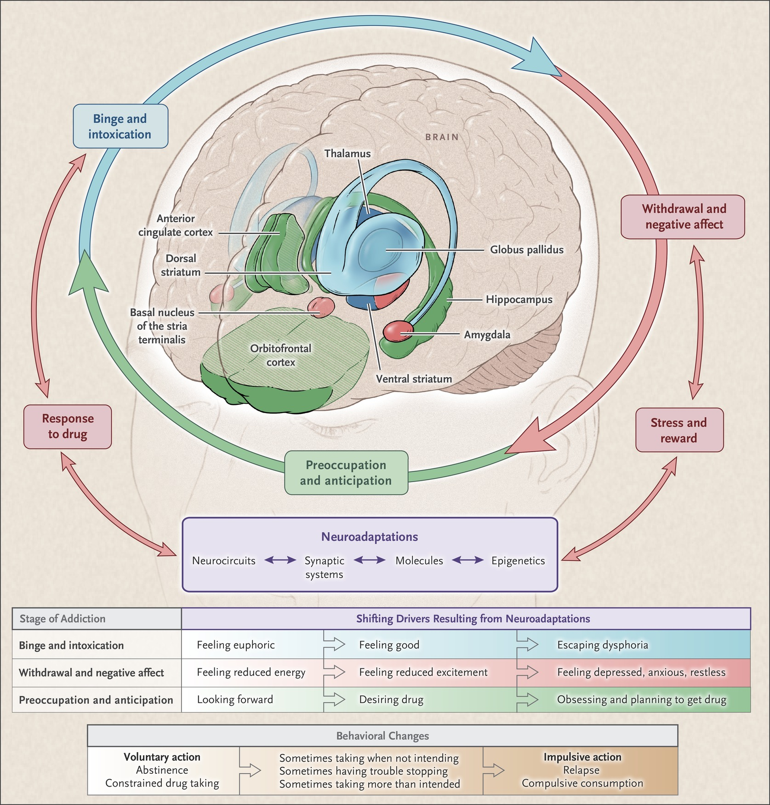
Volkow ND et al. N Engl J Med 2016;374:363-371
Notes:
Figure 1 Stages of the Addiction Cycle. During intoxication, drug-induced activation of the brain’s reward regions (in blue) is enhanced by conditioned cues in areas of increased sensitization (in green). During withdrawal, the activation of brain regions involved in emotions (in pink) results in negative mood and enhanced sensitivity to stress. During preoccupation, the decreased function of the prefrontal cortex leads to an inability to balance the strong desire for the drug with the will to abstain, which triggers relapse and reinitiates the cycle of addiction. The compromised neurocircuitry reflects the disruption of the dopamine and glutamate systems and the stress-control systems of the brain, which are affected by corticotropin-releasing factor and dynorphin. The behaviors during the three stages of addiction change as a person transitions from drug experimentation to addiction as a function of the progressive neuroadaptations that occur in the brain.

Slide 5
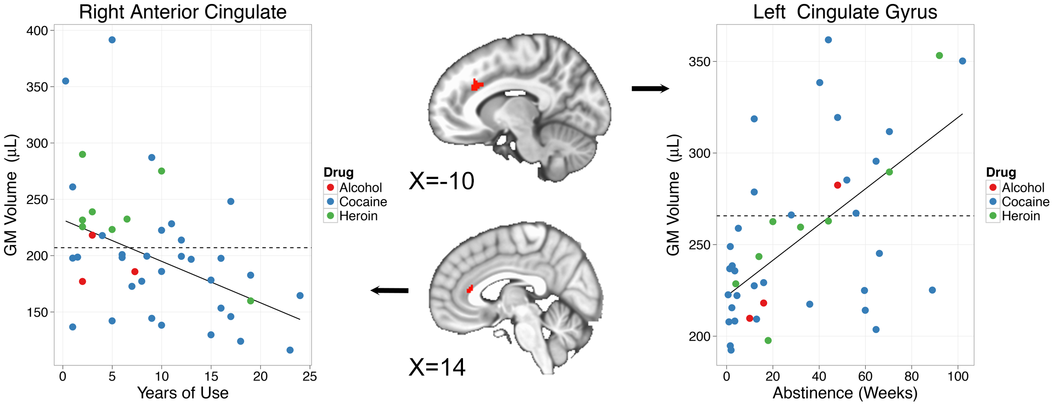
Connolly, Bell, Foxe, & Garavan. PLOS ONE, vol. 8, 2013.

Slide 6
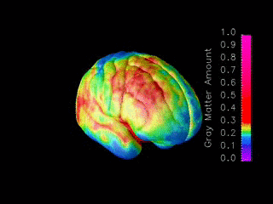
Changes in Cortical Density, Age 4 to Age 20 (from Averaged MRI Data)

